Slide 1
Version Control
Tracking and controlling changes to Your code

Slide 2
What is Version Control?
  The practice of tracking and managing changes to code
    Also known as source control
    Can be used as an individual or by a team
  Usually facilitated through a version control system (VCS) / source code management system (SCM), e.g.:
    Git
    Subversion
  These systems let you control changes to the code over time
    Track changes
    Accept/reject changes
    Merge the work of separate developers

Slide 3
How Version Control Works
  All code is kept in a shared repository
    Repository stores the current version of the source code files
    Repository also stores all previous versions of the files
  If something goes wrong, you can roll back to a previous version.
  Developers in a team can work on separate copies of the code
    Make their changes away from the main project – no impact on others
    Merge the update back in when they are happy with it
  Code must be checked before it is merged into the main project
    Flawed and/or conflicting code can be found, assessed and adjusted before being accepted
Notes:
Useful resource: https://homes.cs.washington.edu/~mernst/advice/version-control.html

Slide 4
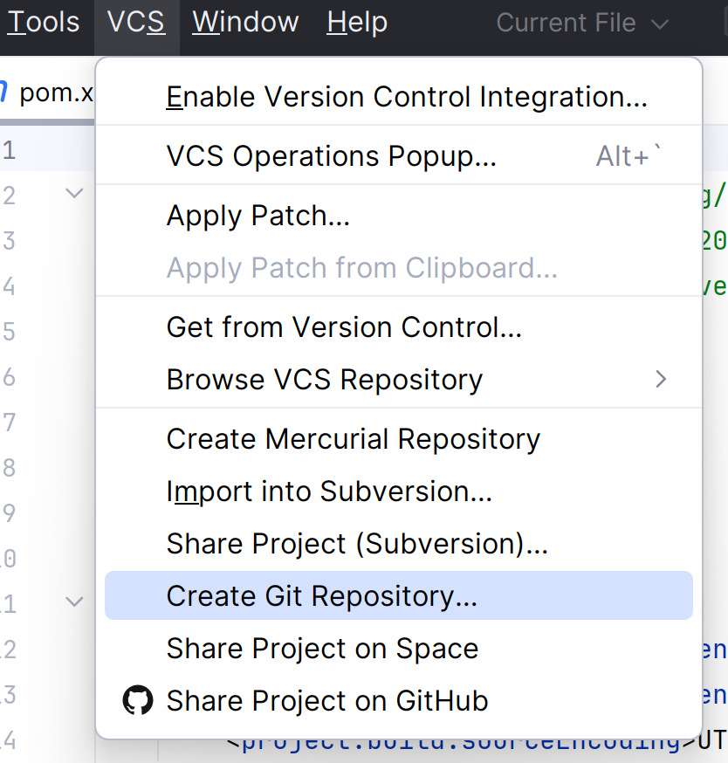
IDEs & Version Control
  Most IDEs have version control tools built in
    You can use these tools on the command line, but we’ll focus on the IDE-integrated ones
  IntelliJ keeps the options to set up version control in the VCS menu of the menu bar.

Slide 5
Wait, Which VCS?
  To use version control, you need a version control system (VCS)
    VCS lets developers manage their repository/repositories
  Different systems do things slightly differently – we will focus on Git
    We’ll discuss the general concepts, but the details are specific to Git
  Why Git?
    One of the most popular version control systems; an industry standard
    Employs a distributed approach
  Git is hosted online through a number of sites, we’ll be using Github

Slide 6
Different Scenarios for Project Set Up
  Sometimes you will start by initialising the project
    This happens primarily on solo work
  Sometimes you will need to start working on an existing project, e.g.:
    Starting work on a new team
    Where your teammate creates the initial project
    Where you are working on a new machine

Slide 7
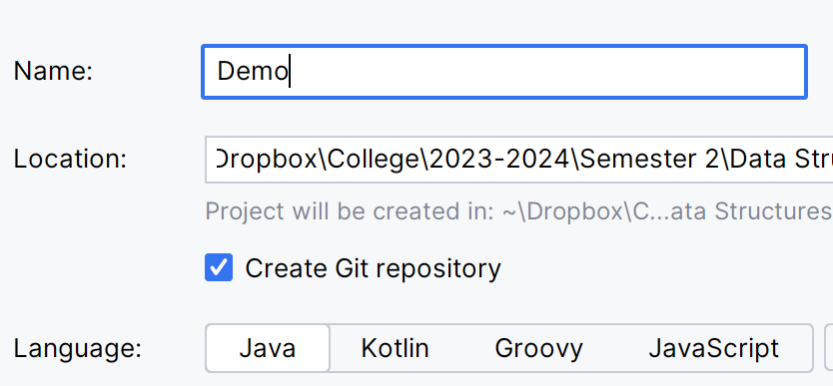
Stage 1)
Creating a Git Repository for Your Project
  The easiest way to set up git on your project is from the very beginning
    Done when you create the project
  Benefit of this approach:
    IntelliJ will ask if you want to add each new file to the list of git-monitored files
    You’ll have them offered as options for inclusion in commits

Slide 8
In Pictures:
Adding a Git Repository to a Project
  Before adding a repository:
  After adding a repository (repo):
Code + History in Snapshots
Project: Code saved in IDE
Project: Code saved in IDE
Project exists
Project (working copy) still exists
Git repository ALSO exists

Slide 9
Stage 1) (Alternative)
Adding a Git Repository to a Project
  You can also add a repository to an existing project:
    Menu -> VCS -> Create Git Repository
  Useful if you have forgotten to add one or decide to add git later
  Downside to this approach:
    You won’t be prompted to add new files to the “git-monitored” set

Slide 10
Stage 2) Setting Up Boundaries
  Software projects are not just made up of source code files, they also include:
    Libraries
    Jars/wars
    Etc
  Tracking these (keeping multiple copies over time) just results in bloated, wasteful repositories
  To avoid this, we can use an ignore file (e.g. gitignore)
    Specify file types and even specific directories to leave out of our repositories
    GitHub provides templates for different scenarios – combine templates to suit your project
    IntelliJ adds a completed gitignore file when creating a git repository

Slide 11
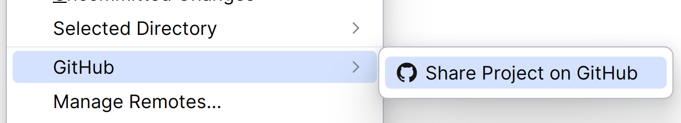
Stage 3) Sharing a Local Repository
  Once the project has a git repository attached, we need to link it with a remote repository.
    Allows code to be shared
    Ensures code redundancy/backup
  To do this, you can share the project on Github:
In IntelliJ’s Git menu

Slide 12
In Pictures:
Sharing a Local Repository Online
Remote repository
Local Machine
Local repository
Working Copy (code in IDE)

Slide 13
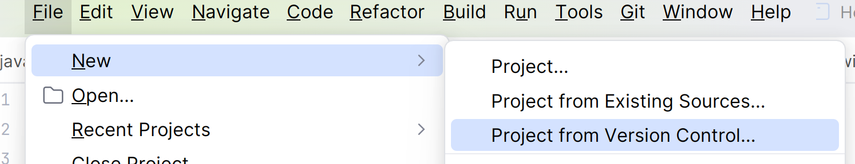
Accessing an Existing VC Project
  Where a project already exists on github and you don’t have a copy on your machine, you need to clone it
    Clone: Create a working copy locally so you can change and add to it
  To clone an existing project, you need to:
    Open the “New Project” menu
    Select “New Project From Version Control”

Slide 14
What Does clone Mean?
  Clone sets up a new local git-tracked copy of a project
    If you create a git-tracked project on your laptop, you can make a clone on your desktop
  Whatever work is done in the clone can be added to the overall project
    You can start writing a new method on your desktop’s project clone and it can appear* in the copy on your laptop
Notes:
*with some help! See the next few slides for how this happens

Slide 15
In Pictures:
Cloning a Repository
Remote repository
After cloning, we have two separate copies connected to the same shared central repository
Original
Clone
Local repository
Local repository
IDE working copy
IDE working copy

Slide 16
Stage 2) Working on an Existing
Version-Controlled Project
  Once you have a working copy of a VC project, you can do any of the following basic actions:
    Commit – Save the current version of your machine’s working copy into your local repository
    Pull – Get an updated copy of the project from the remote repository
    Push – Upload all commits not yet uploaded to the remote repository
Remote Repository
PUSH
PULL
Local Repository
COMMIT
UPDATE
Working Copy

Slide 17
Commit – Saving a Change to Your Working Copy
  Once you’re satisfied you’ve finished a stage/reached a logical break, you commit the current state of the working copy to your local repository
    Saving the code in your IDE saves the files in the working copy
    Committing the code to the local repository stores the updates locally within the version control system
  When you make a commit, you should include a commit message
    Message should explain the purpose of the commit, so you can find changes easily
  Note: Try not to commit broken code – you want your repository to contain functional code as much as possible

Slide 18
Committing Strategy
  You might be tempted to commit large chunks at once, but don’t!
    Doing this makes it harder to take advantage of many of source control’s benefits
  Good committing strategy: Regularly commit small functional sections of code
    Commit as you complete a logical unit (once you confirm it’s working - don’t commit broken code!)
  This builds the project in a more granular manner
    Can roll back small sections instead of losing “loads” of work
    Can merge in changes more easily – smaller pieces to combine

Slide 19
Pull – Updating Your Working Copy
With the Latest Changes
  “Pulling” code from a VC project updates the working copy to match the files in the remote repository
  Pull is an important action for a number of reasons:
    If you are working in multiple locations
    If you are working in a team
  Team usage is a major motivator
    Pulling the code updates your project with the work of other team members

Slide 20
Push – Uploading Your Commits to the Remote Repository
  Pushing your commits uploads all your stored changes to the remote repository
    Any changes you have saved in your IDE, but have not yet committed, will NOT be uploaded
  Pushing:
    Allows other team members update their code with your changes
    Backs up the changes
    Adds the changes to the history of the project

Slide 21
VCS: A Sample Work Flow
  Create the project and repositories/Clone the remote repository
  Write code
  Commit progress to local repository
  Pull updates from remote repository
  Push code to remote repository
  You should always pull before you push, as
    Pulling lets you detect conflicts
    Repairing these conflicts locally before merging changes is crucial
Repeat
Notes:
You don’t need to pull if:
You are the only developer working on the project
AND
You haven’t committed changes to the repository in other locations.

Slide 22
Conflicts – A Wrinkle in Team Work
  When sharing a code base, team members will inevitably change sections of code that others are also working on
    Where the code is compatible, the VCS merges the different versions together
    Where the code is not compatible, a conflict occurs
  Conflict: Two different users push code that has edited the same line in a file.
    The problem: Which should the VCS use?
  Conflicts are solved through manual intervention
    User pushing conflicting code assesses what the best solution is

Slide 23
Bonus Feature: Viewing Differences
  An extra feature outside of the core three is diff
  Diff lets you see the differences between the current version of your code and:
    The local repository, i.e. to the last commit (diff to HEAD)
    The remote repository (diff to repository HEAD)
  Diffing to the local repository is useful to see what you have done in a file since you last committed, e.g.:
    If you have been away
    If you have been working on another project
  Diffing to the remote repository is useful to see what other team members have added since you last pulled
    Early warning if the new features might impact what you’re working on

Slide 24
Beyond Commit, Push and Pull
  This is only the start of working with version control systems
    There are many other features available
  In the future, we’ll look at are merging and branching
  Merging: Combining your new changes with the existing project
    Where multiple team members are pushing changes, this is a common action!
  Branching: Creating a duplicate remote repository of the original that is still linked to the original – like branches off a tree trunk
    Team members can create their own branches to work in, then merge them together to create larger features and fixes

